Slide 1
BUDGET SALES ANALYSIS
By Vanshika Rawat

Slide 2
OBJECTIVES
Top 10 Products with highest Market Capital.
Top 10 Products with highest Quarterly Sales.
Bottom 10 Products with lowest Market Capital.
Bottom 10 Products with lowest Quarterly Sales.
07/04/2024

Slide 3
THE PROCESS
Data Collection
Data Cleaning
Data Analysis
Conclusion
07/04/2024

Slide 4
DATA COLLECTION
The Data has been collected in the form of a XLSX file named “AdventureWorks_Database.xlsx” & “Budget.xlsx”
The XLSX file has the data (Sales Order ) of 58190 orders .
07/04/2024

Slide 5
DATA CLEANING
Identify and deal with missing data appropriately.
Check for and eliminate duplicate records. Removed the unwanted columns FiscalYear, FiscalQuarter, FiscalMonthNum etc.
Standardised the data formats.
07/04/2024

Slide 6
DATA ANALYSIS
Data analytics techniques to scrutinize sales performance, identify trends, and optimize resource allocation. Through meticulous examination of sales data, it uncovers actionable insights that inform strategic decision-making, facilitating efficient budget allocation and maximizing revenue potential.
07/04/2024

Slide 7
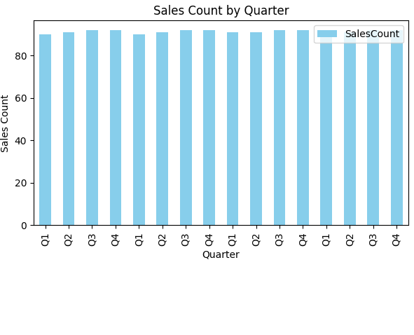
DATA ANALYSIS
BUDGET SALES COUNT QUARTERLY
07/04/2024

Slide 8
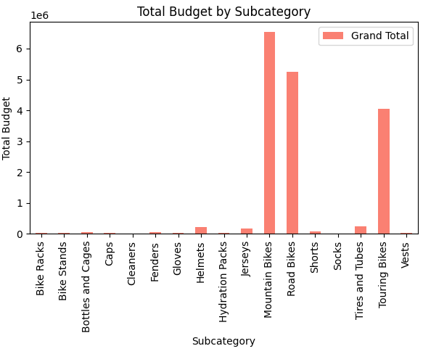
DATA ANALYSIS
TOTAL BUDGET SALES
07/04/2024

Slide 9
CONCLUSION
In conclusion, a comprehensive budget sales analysis is instrumental in optimizing revenue and driving business success. By leveraging data-driven insights and strategic planning, organizations can achieve sustainable growth and financial stability.
07/04/2024

Slide 10
THANK YOU
05/04/2024

